Slide 1

CS 5260 Part 1
Ishan Kaul

Slide 2
Introduction
Optimize schedule of 'trades' and 'transforms' of resources for one country in a game world, according to a defined quality function
Forward-searching, anytime, depth-bounded, utility-driven

Slide 3

Resources
AvailableLand, Water, Population, PopulationWaste, MetallicElements, Timber, Farm, FarmWaste, MetallicAlloys, MetallicAlloysWaste, Electronics, ElectronicsWaste ,Housing, HousingWaste, Food, FoodWaste, PotentialFossilEnergy, PotentialFossilEnergyUsable, PotentialFossilEnergyUsableWaste, PotentialRenewableEnergy, PotentialRenewableEnergyUsable, PotentialRenewableEnergyUsableWaste

Slide 4

Transforms
Build Housing
Manufacture Alloys
Manufacture Electronics
Produce Food
Build Farm
Produce Fossil Fuels
Produce Renewable Energy
Treat water

Slide 5
Transfers
Represent 'trades' with other countries
Resource 'weights' specified in input file; represent value of each resource with respect to a standardized currency
Productive resources – positive weights; waste resources – negative weights

Slide 6
Scaling
All transforms and transfers can be 'scaled' to however much of the input resource the country has

Slide 7
State Quality
Same function used for each country
Factors
Population
Necessities – water, food, housing
Secondary – Electronics, PotentialFossilEnergyUsable, PotentialRenewableEnergyUsable
Waste

Slide 8
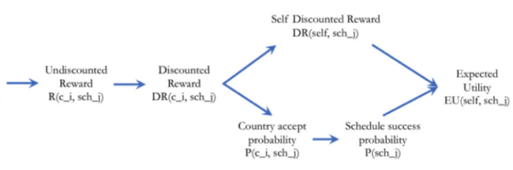
Calculating Utility

Slide 9
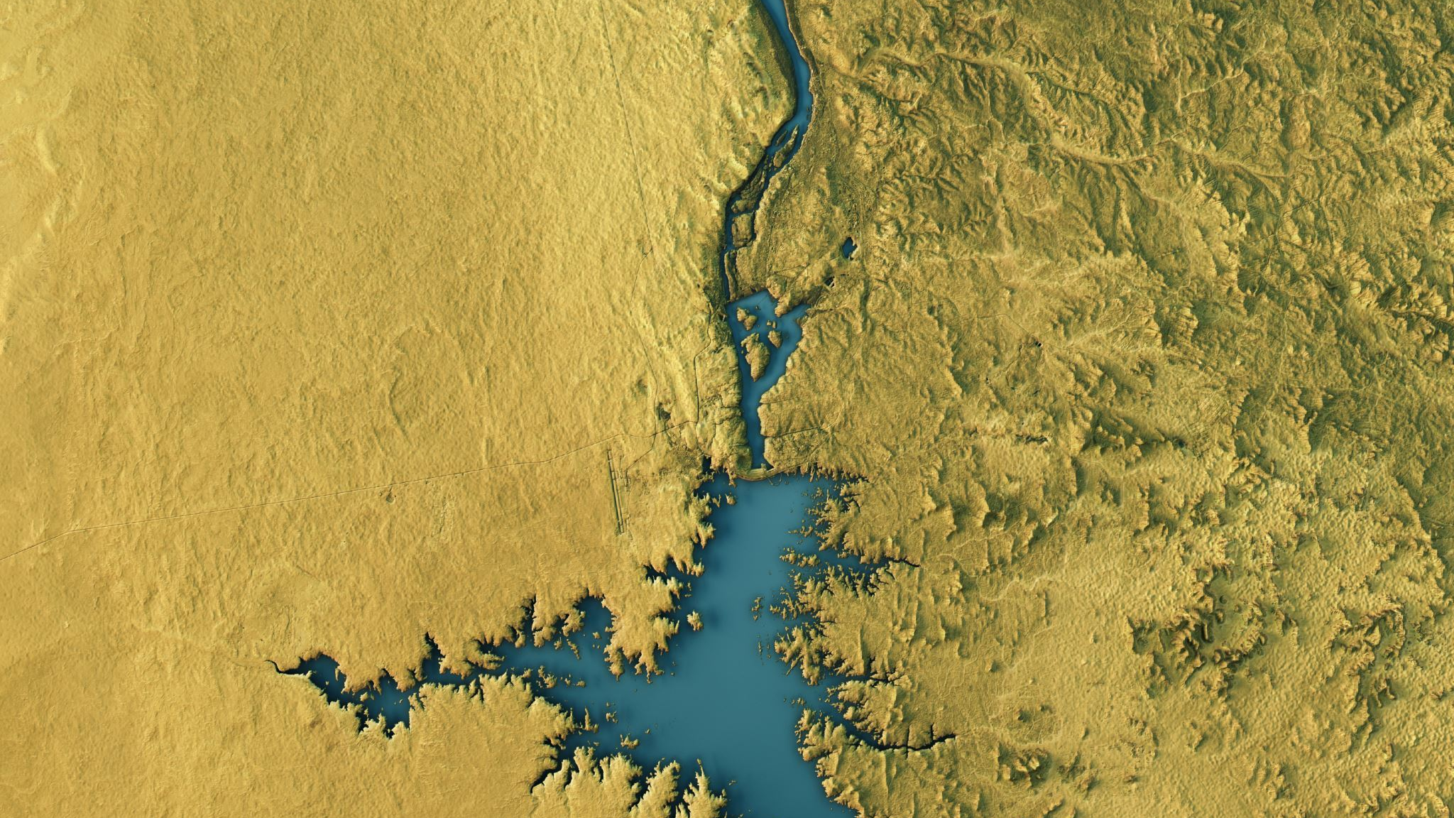
Search Algorithm
Frontier and best states list: double ended priority queues
Beam search: frontier at maximum size
Pop best state off frontier first, and generate successors
Only place successor on frontier if higher utility than worst of current frontier

Slide 10

Tests and Experiments

Slide 11

Initial State Test
Goal: observe scheduler's response to different initial states
Constant parameters other than initial state file
Cases
Low food and housing
High housing, water, farm; low food
Gross excess of water and renewable energy; low levels of everything else
Plethora of resources, too much waste

Slide 12
Depth Test
Effect of depth on runtime and best utility
All other params kept constant

Slide 13
Frontier Size Test
Effect of frontier size on runtime and best utility
All other params kept constant

Slide 14
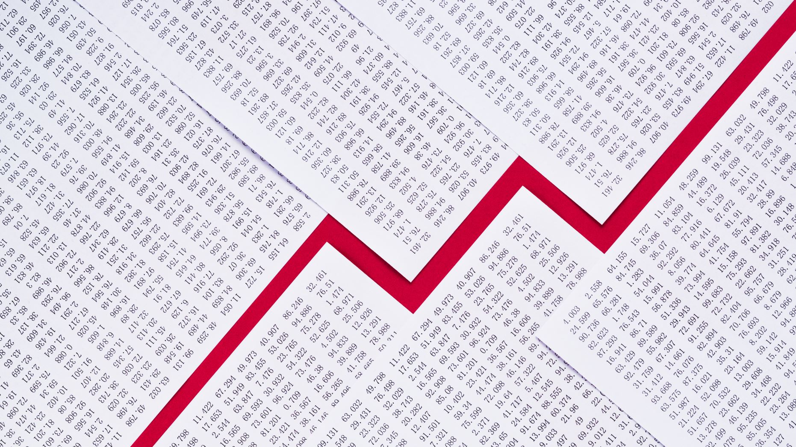
Results

Slide 15
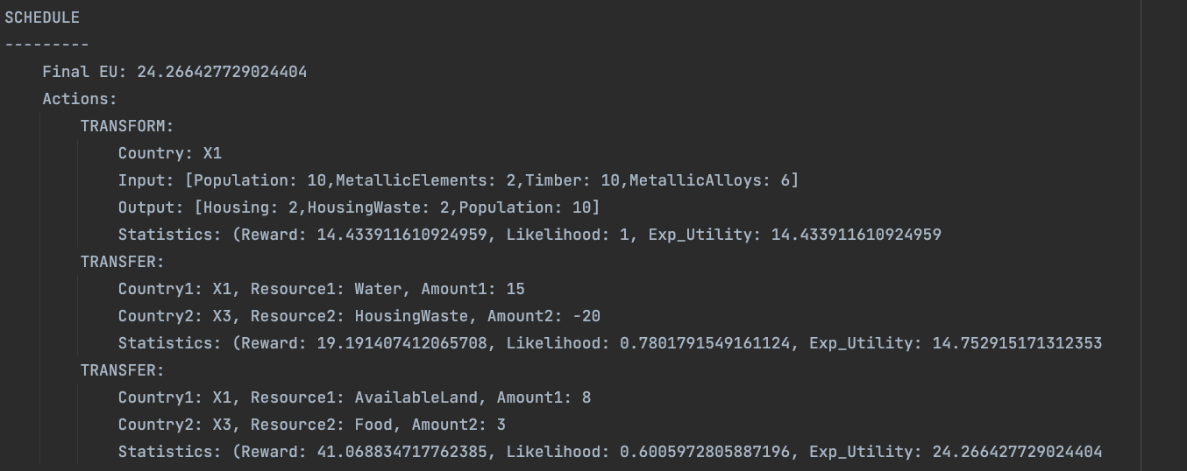
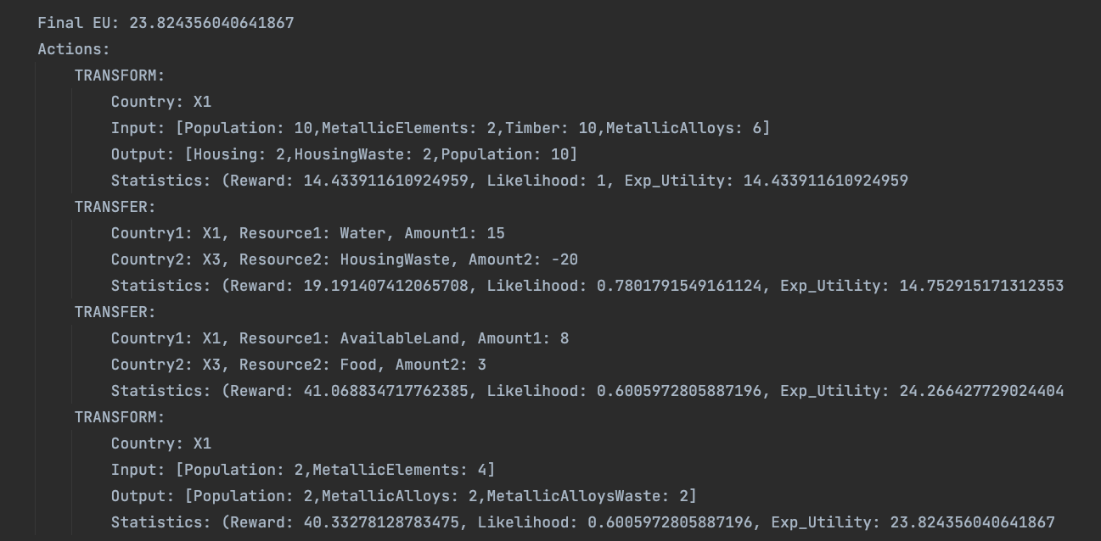
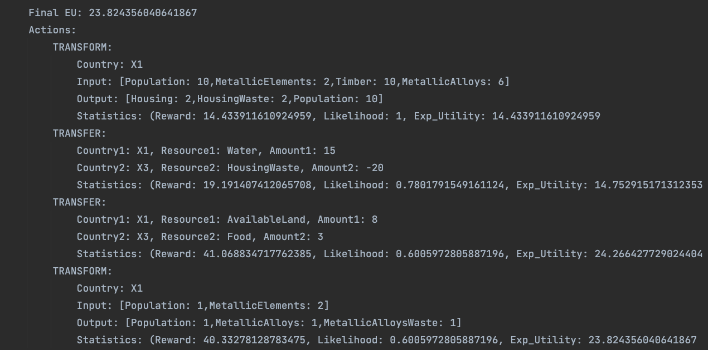
Top 3 Output Schedules: Low Housing and Food

Slide 16
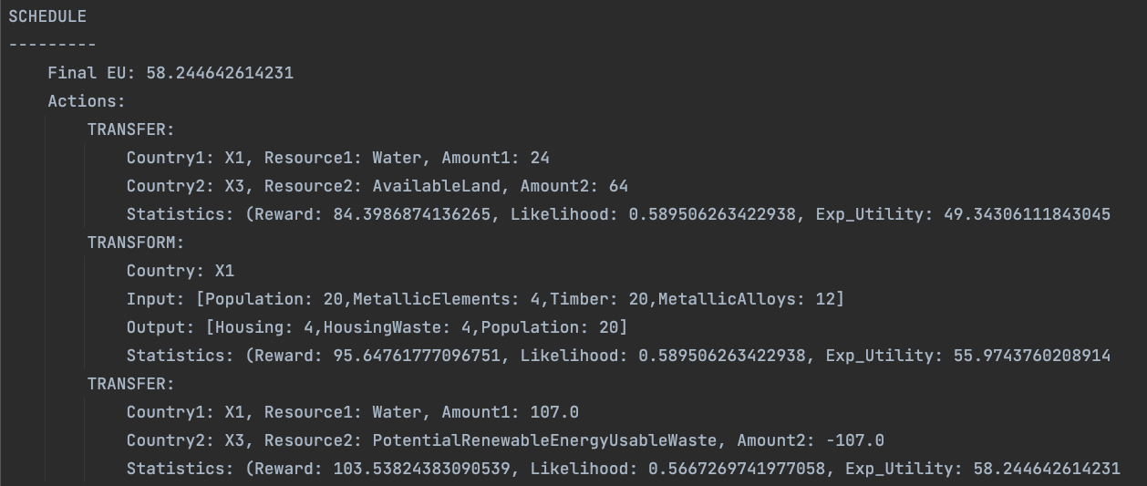
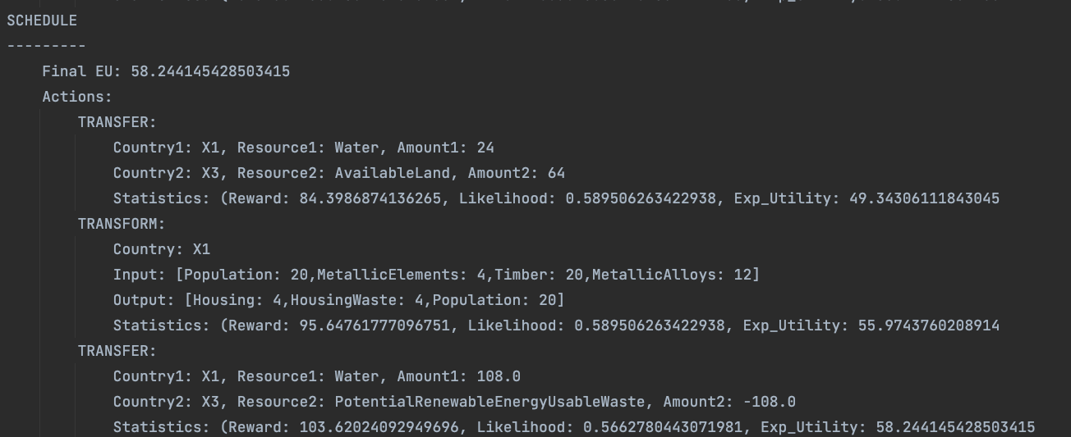
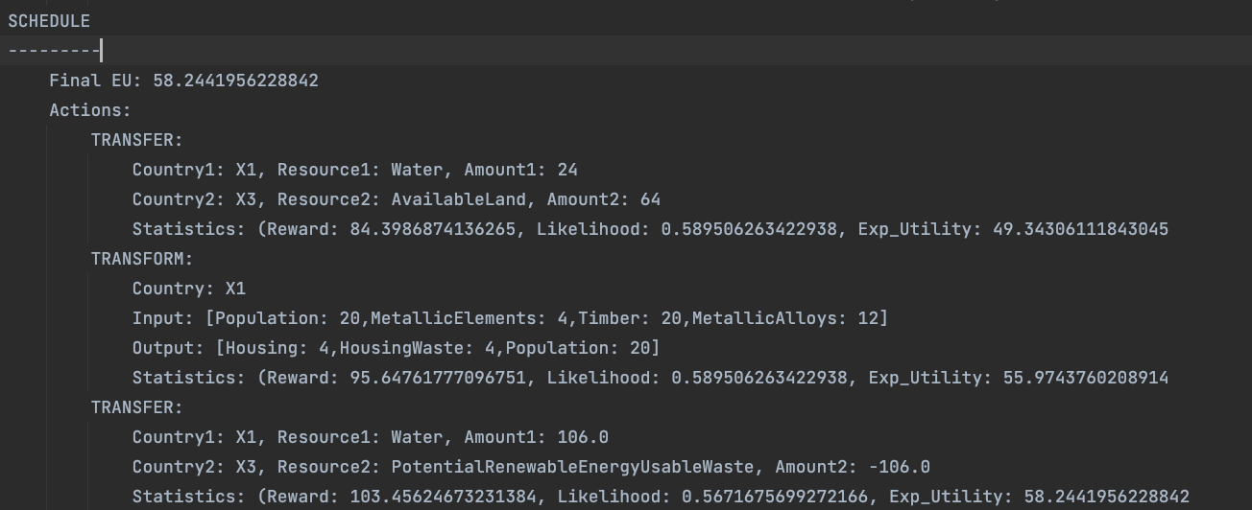
Top 3 Output Schedules: Lots of resources and waste

Slide 17
Depth Results

Slide 18
Frontier Size Results

Slide 19

Analysis
Frontier and Depth: approximately linear with respect to runtime
Expected Utility doesn’t seem to improve much past depth of 3
Algorithm makes aggressively greedy move first, then gets stuck in small area of state space

Slide 20
Citations
Wikipedia article for Sigmoid Function
Class slides, lectures, and book
DEPQ Python library

